Slide 1
Building a Leadership Seniority Pyramid
POLS 1101 Spring 2016
Lab 3, Step 2

Slide 2
Open your Spreadsheet
Open the Excel Spreadsheet that you created with the Membership Roster on the first Worksheet
The naming convention you should have used is either:
Senate Judiciary 114th

Slide 3
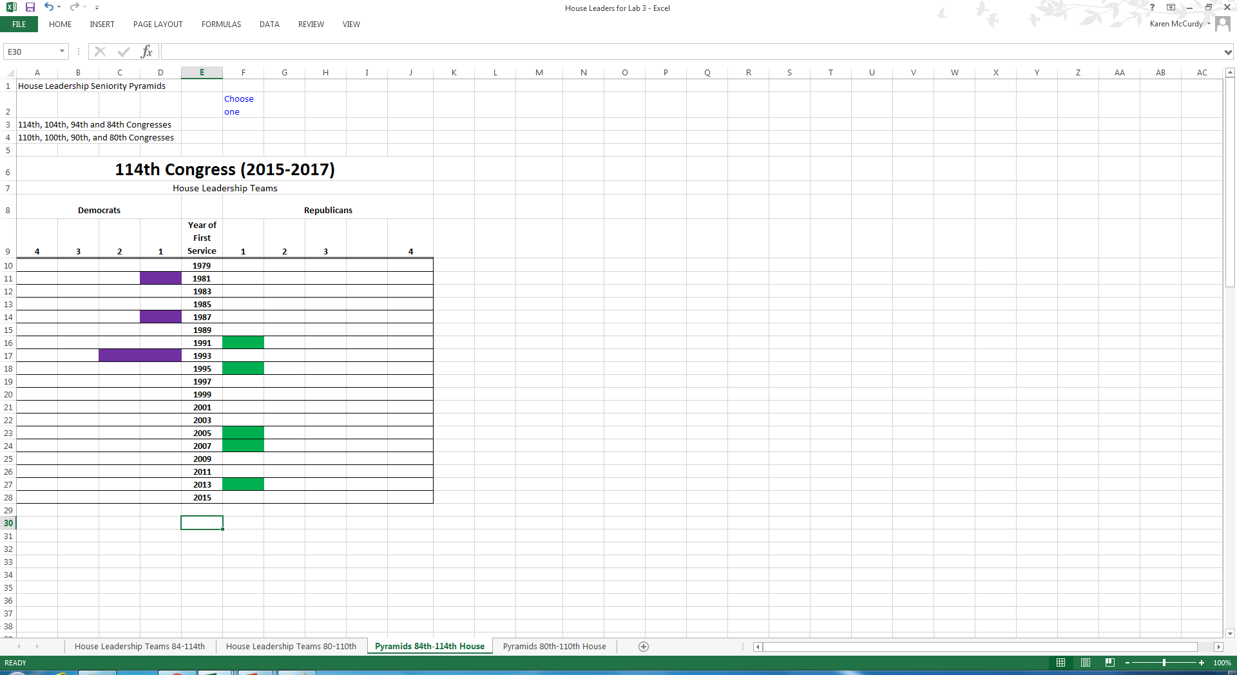
The finished Seniority Pyramid
You will create a Seniority Pyramid (or Chart) for the Subcommittee of the Senate Judiciary Committee you select

Slide 4
Setting up the Seniority Pyramid
To get a file like that shown on the previous slide, take a few simple actions
Open the worksheet tab in the Excel file that matches your data
Select the Roster Tab which contains the data you just finished entering
Print this page (or have a second device that allows you to display this page)
You will be going back and forth between screens a lot for the next part of the exercise

Slide 5
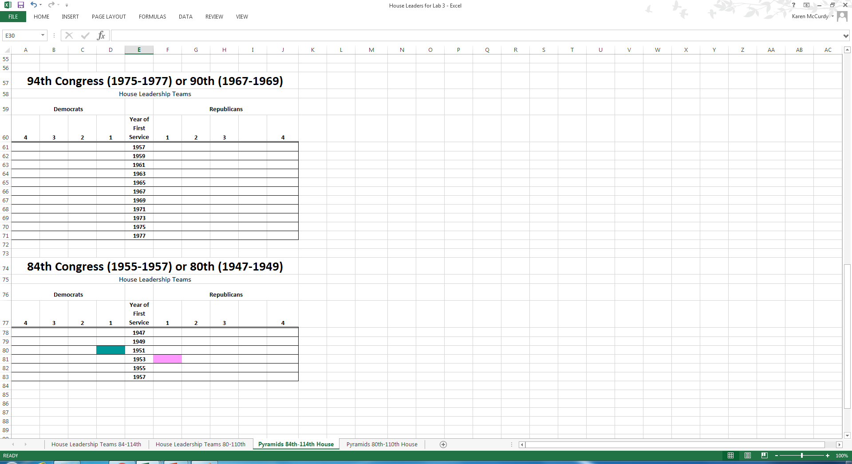
Beginning Worksheet
When you begin, you will have a template that needs to be altered for your purposes.

Slide 6
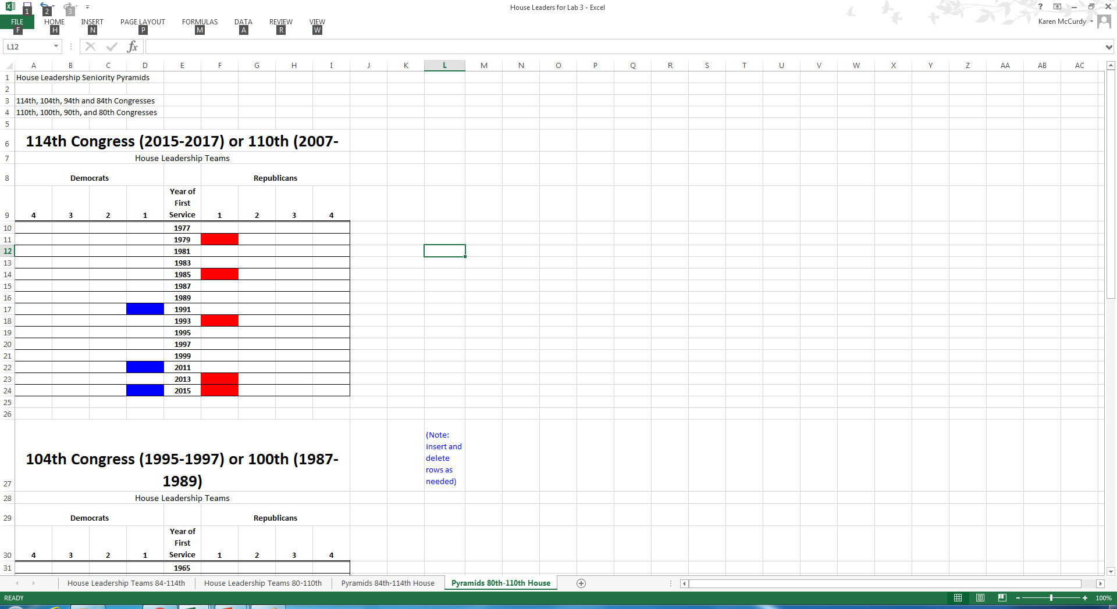
First steps with a blank worksheet
Put information for
Yourself in the upper
Left corner cells
Rename the tab
from Sheet2

Slide 7
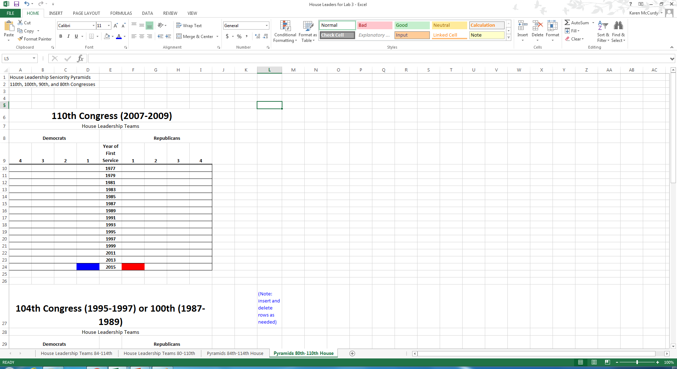
Edit Identifying Titles
Edit the words in the title“110th Congress (2007-2009)”
Insert or Delete rows as needed
Change colors to what you like

Slide 8
Add or Delete Rows, and Numbers to Year First Served Column
The individual Senators on the subcommittee will have different service years
You must edit
the rows

Slide 9
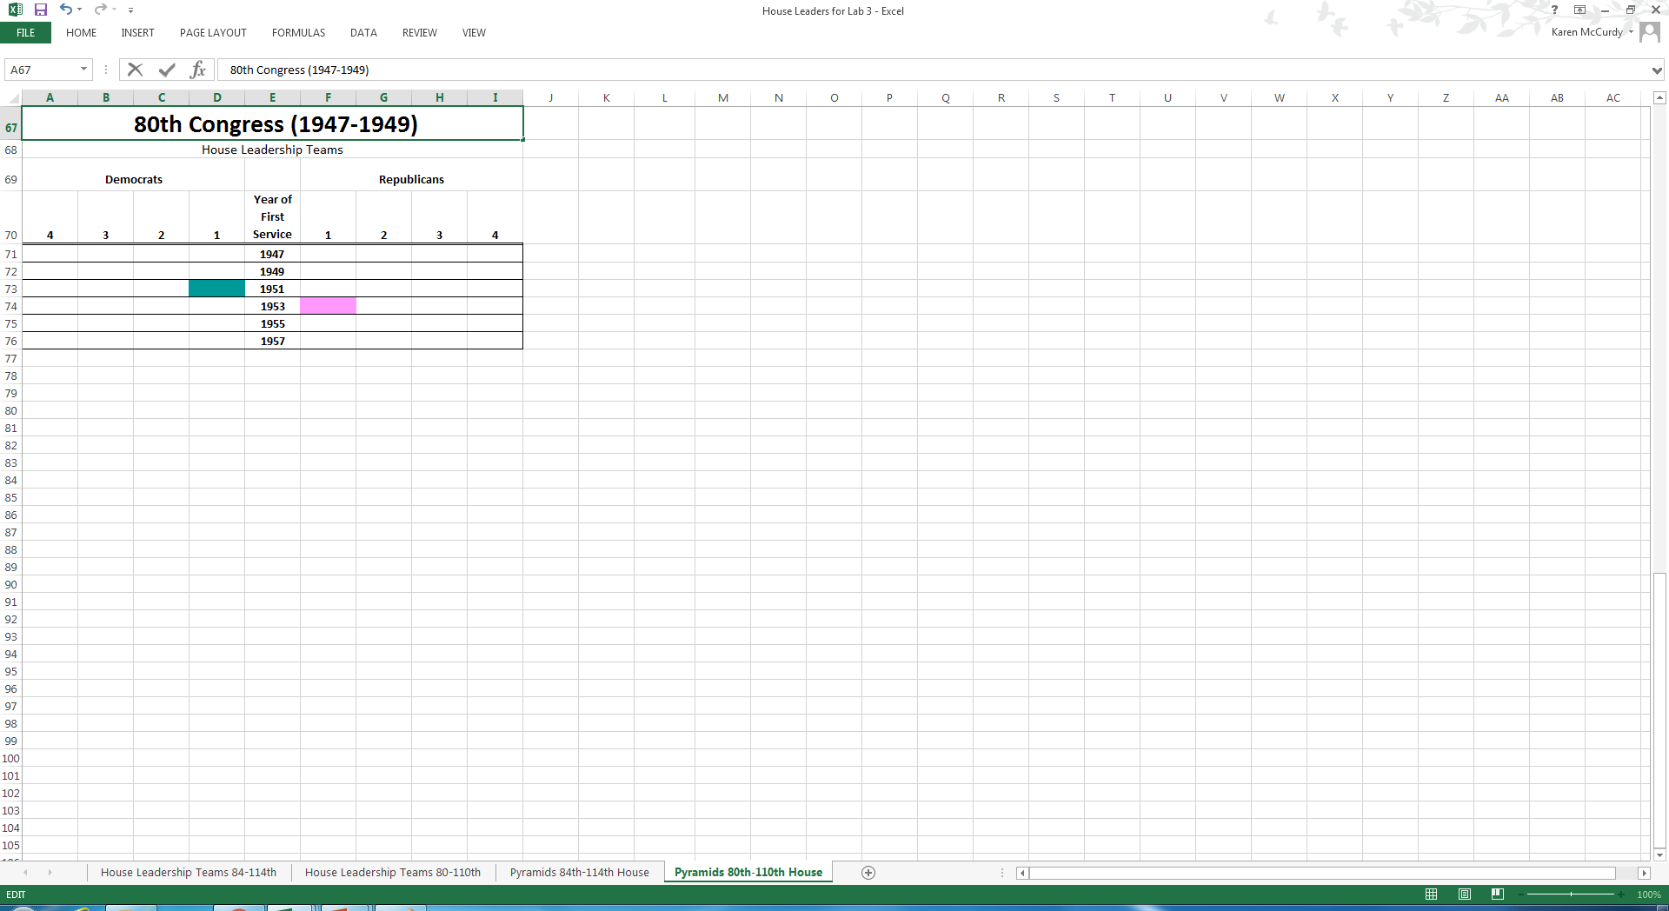
Count Members first serving in the House in a given year
Highlight the cells corresponding to the number of Republican Members first serving in the year of interest
Select a color for Republicans, Repeat for Democrats
Use the “Fill Color” bucket to paint the cells

Slide 10
Almost Done
Paint a cell for each member of your subcommittee, using the appropriate party color and year of First Service row
You may choose whatever color scheme appeals to you
You are now ready to begin your analysis
Describe the patterns you see
Compare between years
Compare between the Subcommittee pyramid you create and the Full Senate Pyramid available on Folio

Slide 11

Compare your subcommittee to the Full Senate
 |  |  |  |  |  |  |  |  |  | 114th Senate
 |  |  |  |  |  |  |  |  |  |  | Democrats |  |  |  |  |  | Republicans
 | 15 | 14 | 13 | 12 | 11 | 10 | 9 | 8 | 7 | 6 | 5 | 4 | 3 | 2 | 1 | Year | 1 | 2 | 3 | 4 | 5 | 6 | 7 | 8 | 9 | 10 | 11 | 12 | 13 | 14 | 15
GRF |  |  |  |  |  |  |  |  |  |  |  |  |  |  |  | 1975
JC | President Barack Obama |  |  |  |  |  |  |  |  |  |  |  |  |  |  | 1977
 |  |  |  |  |  |  |  |  |  |  |  |  |  |  |  | 1979
RR | Minority Leader Harry Reid |  |  |  |  |  |  |  |  |  |  |  |  |  |  | 1981
 |  |  |  |  |  |  |  |  |  |  |  |  |  |  |  | 1983 |  |  |  |  | Majority Leader Mitch McConnell
 |  |  |  |  |  |  |  |  |  |  |  |  |  |  |  | 1985
 |  |  |  |  |  |  |  |  |  |  |  |  |  |  |  | 1987 |  |  |  |  |  |  |  |  |  |  |  |  |  |  |  | Pledge 1986
GHWB |  |  |  |  |  |  |  |  |  |  |  |  |  |  |  | 1989
 |  |  |  |  |  |  |  |  |  |  |  |  |  |  |  | 1991
WJC |  |  |  |  |  |  |  |  |  |  |  |  |  |  |  | 1993
 |  |  |  |  |  |  |  |  |  |  |  |  |  |  |  | 1995
 |  |  |  |  |  |  |  |  |  |  |  |  |  |  |  | 1997
 |  |  |  |  |  |  |  |  |  |  |  |  |  |  |  | 1999
GWB |  |  |  |  |  |  |  |  |  |  |  |  |  |  |  | 2001
 |  |  |  |  |  |  |  |  |  |  |  |  |  |  |  | 2003
 |  |  |  |  |  |  |  |  |  |  |  |  |  |  |  | 2005
 |  |  |  |  |  |  |  |  |  |  |  |  |  |  |  | 2007
BHO |  |  |  |  |  |  |  |  |  |  |  |  |  |  |  | 2009
 |  |  |  |  |  |  |  |  |  |  |  |  |  |  |  | 2011
 |  |  |  |  |  |  |  |  |  |  |  |  |  |  |  | 2013
 |  |  |  |  |  |  |  |  |  |  |  |  |  |  |  | 2015
 |  |  |  |  |  |  |  |  |  |  |  |  | 44 Dem/54 GOP/2 Indep
Democrat
Republican
Independent

Slide 12
Draft your letter
Using the insight you gained from examining the members of the subcommittee, draft a letter urging the Senator you select to take a specific policy position
Remember that you are persuading the person who holds the vote
Show your understanding of the situation, and
Explain why the correct position is yours

Slide 13
Proofread and Upload
Let your letter sit for at least one hour
(Yes, it is a good idea to have your draft completed 24 hours before you need to upload it.)
Proofread your letter and your roster and pyramid
Watch for Capital letters and any of my instructions that are remaining on your file
Save the letter as a PDF and upload
Save the Excel file, and upload as is

Slide 14
Reward yourself
Before the deadline
Double check that you uploaded the correct files
Don’t panic if you made a mistake here, just upload the correct files and leave me a note that indicates which files are the ones you want to be graded
After the deadline
Relax and do something fun

